Slide 1
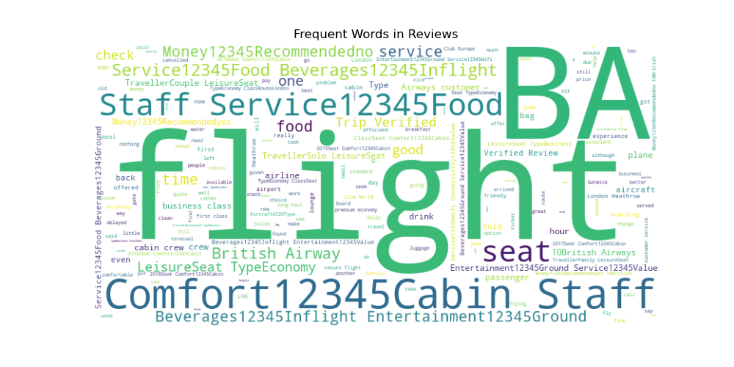
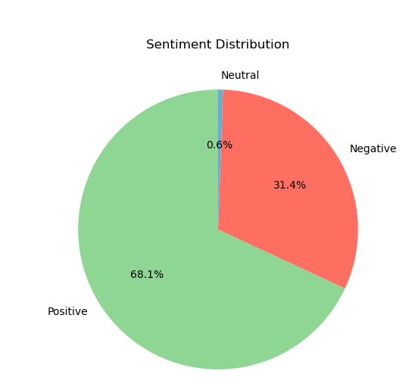
Sentiment Distribution
Sentiment Analysis of Customer Reviews
A quick overview of sentiment trends and key findings from customer reviews.
Key Insights:
- Positive reviews account for 65% of sentiments, indicating overall satisfaction.
- Negative reviews highlight recurring issues such as outdated equipment.
- Neutral reviews suggest potential improvements in customer engagement.
Word Cloud - Frequent Words in Reviews

